Slide 1
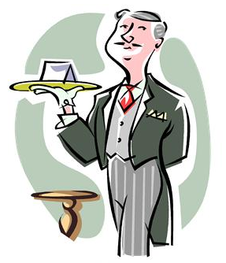
Biblical Lessons on Christian Stewardship
Rev. Dr. Otis T. McMillan, General Secretary
The Department of Church Growth and Development The African Methodist Episcopal Zion Church
3225 West Sugar Creek Road, Charlotte, NC 28221
www.beamezion.org www.otismcmillan.org
Scripture Reference: 2 Corinthians 8:1-5

Slide 2
Teaching Believers the Importance of Christian Stewardship
Biblical Lessons on Christian Stewardship
Scripture Reference: 2 Corinthians 8:1-5
Proposition:
Christian Stewardship is an acknowledgement of God’s divine ownership of the World, the fullness there of and He has a perfect right to govern and dispose of all as seemeth good in His sight, yet He has placed the management of His world in our care. We must prove ourselves to be good stewards for His glory.

Slide 3

The first step in our Christian Stewardship is that of giving ourselves to God.
2Corinthian 8:1-5

Slide 4


Basic Bible in English Version
2Co 8:1 And now we give you news, brothers, about the grace of God which has been given to the churches of Macedonia;
2 How while they were undergoing every sort of trouble, and were in the greatest need, they took all the greater joy in being able to give freely to the needs of others.
3 For I give them witness, that as they were able, and even more than they were able, they gave from the impulse of their hearts,
4 Seriously requesting us that they might have a part in this grace of being servants to the needs of the saints:
5 And going even farther than our hope, they first gave themselves to the Lord and to us after the purpose of God.

Slide 5

Christian Stewardship
a. Christian Stewardship should not depend on favorable circumstances. (v.2)
b. Christian Stewardship is the response of a willing heart. (v.3)
c. Christian Stewardship is a demonstration of our love and concern. (v.4)
d. Christian Stewardship is an easy response when we give ourselves to God. (v.5)
e. Christian Stewardship makes it possible to give ourselves to God’s delegated authority. (v.5)

Slide 6

Once we give ourselves to Christ, then He has our treasures also.
1Ch 29:14 But who am I, and what is my people, that we should be able to offer so willingly after this sort? for all things come of thee, and of thine own have we given thee.

Slide 7


Christian Stewardship in Action
a. Christian Stewards have received power and are willing to share the Gospel message, both by their preaching and suffering. (Acts 1:8)
b. Christian Stewards have received special gifts and are willing to use their gifts and graces to advance the kingdom of God. (1 Peter 4:7-11)
c. Christian Stewards have received increase from the Lord’s hand and are willing to honor the Lord with their substance. (Proverbs 3:8)

Slide 8
Christian Stewardship in Action
d. Christian Stewards who have given their heart to Christ, their treasures to God and His cause, can expect a bountiful harvest from the Lord. (Proverbs 3:7, 8, 10)
1. A harvest of good health (v.7)
2. A harvest of abundance increase. (v.10)
3. A harvest of new joy and fulfillment. (v.10)
e. Christian Stewards doing works of charity, and other good works, should perform such acts with thought and design to receive God’s best. (2 Corinthian 9:6-9)

Slide 9
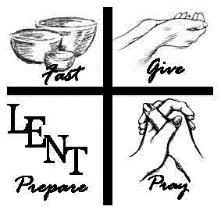
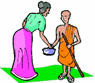
Biblical Lessons on Giving Alms
Matthew 6:1-4
Mt 6:2-4 Therefore when thou doest thine alms, do not sound a trumpet before thee, as the hypocrites do in the synagogues and in the streets, that they may have glory of men. Verily I say unto you, They have their reward. But when thou doest alms, let not thy left hand know what thy right hand doeth: That thine alms may be in secret: and thy Father which seeth in secret himself shall reward thee openly.

Slide 10
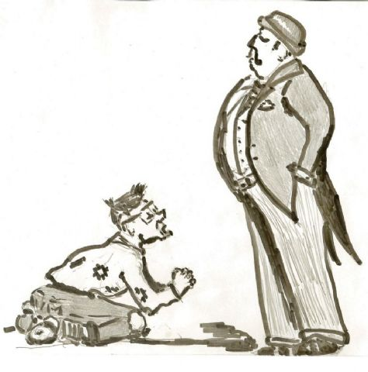

Proposition
An important aspect of our Christian Stewardship is the wise and faithful use of the treasures with which God has entrusted us. Our giving of alms should be a holy duty, carefully performed, not for our own honor, but for God’s pleasure.
Since we will have the poor with us always, a part of our Christian stewardship is to give alms to the poor. How should they be given and why? (Matt. 26:11)

Slide 11

How should alms be given and why?
Mt 26:11 For ye have the poor always with you; but me ye have not always.

Slide 12


1. Christian stewards do not give alms to impress men. (Matt. 6:1, 2)
2. Christian stewards do not give alms to receive the temporary reward of men. (6:2)
3. Christian stewards giving alms in secret attracts God’s attention and receives God’s Reward. (Matt.6:3)

Slide 13

4. Christian stewards who are anxious to have their donations publicly acknowledged, should take warning from these words. (Matt 6:4)
5. Christian stewards are promised special blessings for giving to the poor. (Proverbs 19:17)

Slide 14
6. Christian stewards who give to the poor and to the Lord’s cause make deposits in the Bank of Eternity. (Matt.6:19)
7. Christian stewardship reflects the position of the believer’s heart as it relates to where his treasure is laid up.(Matt. 6:20)
8. Christian stewards entrust their treasures to God for safe keeping from decay, and robbery: for in no other place is their treasure secure. (Matt. 6:21)
9. If our choicest possessions are on the earth, our heart will be earth-bound. (Matt. 6:21)

Slide 15
10. If God be the treasure of our souls, our hearts, our affections and desires will be placed on things above. An earthly minded man proves that his treasure is below; a heavenly minded man shows that his treasure is above. (Luke 12:33,34)
11. Christian stewards choose to do good at whatever time or place, and in whatever manner they can.(Gal. 6:10)
12. Christian Stewardship is the true test of our Godly love. (1 John 3:16-17)

Slide 16
1John 3:16 - 18
16 In this we see what love is, because he gave his life for us; and it is right for us to give our lives for the brothers.
17 But if a man has this world's goods, and sees that his brother is in need, and keeps his heart shut against his brother, how is it possible for the love of God to be in him?
18 My little children, do not let our love be in word and in tongue, but let it be in act and in good faith.

Slide 17

Biblical Lessons on Old Testament Biblical Tithing
Genesis 14:7-20; 28:20-22, Malachi 3:7-12
Mal 3:10 Bring ye all the tithes into the storehouse, that there may be meat in mine house, and prove me now herewith, saith the LORD of hosts, if I will not open you the windows of heaven, and pour you out a blessing, that there shall not be room enough to receive it.

Slide 18
Proposition
A vital part of our Christian Stewardship is that of giving our tithes to God. A study of the Biblical Tithe is important because informed Christian Stewards can give in faith, love, claiming the promises of God without becoming legalistic.

Slide 19

Biblical tithing preceded the Mosaic Law and were included in the mosaic law

Slide 20

1. Biblical tithing preceded the Mosaic Law. (Genesis 17-20
Abraham, the father of the faithful is the first known tither in the Bible. (Genesis 14:17-20)
Jacob, Abraham’s grand son was a tither. (Genesis 28:20-22)

Slide 21
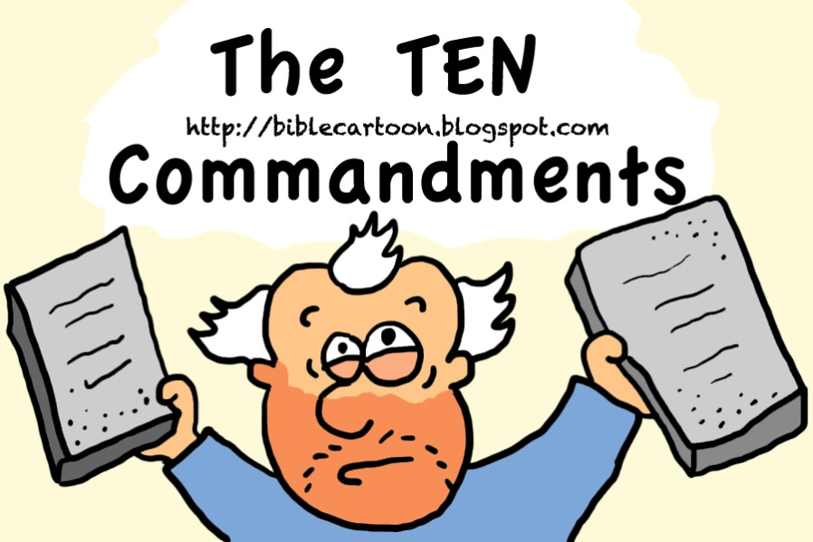
Biblical tithing was a part of the Mosaic Law.
The tithe was holy unto the Lord. (Lev. 27:30)
Failure to tithe was a serious matter to God. (Mal. 3:7-9)
Faithfulness to biblical tithing will result in God’s blessing. (Mal. 3:7-12)

Slide 22


Biblical Lessons on Giving Freewill Offering
Scripture Reference:
Leviticus 1:2, 3
1Chronicles 29:9
2Corinthians 9:7

Slide 23

Proposition
The Christian stewards must offer their offerings voluntarily. What is done in religion, so as to please God, must be done by no other constraint than that of love for God. God accepts the willing people and the cheerful givers.

Slide 24
Giving That Pleases God
God gave guidelines for giving offering and sacrifice that we might serve Him with honour and obtaining of His favour. (Lev. 1:2, 3)
What is done in works of piety and charity should be done willingly, not by constraint; for God loves a cheerful giver. David set a good example. David offered, not from constraint, or for show; but because he had set his affection to the house of God, and thought he could never do enough towards promoting that good work. (1Chronicles 29:1-9)

Slide 25
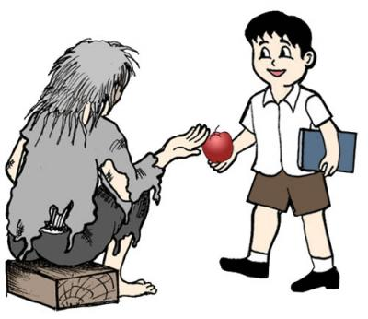
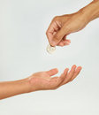
Giving That Pleases God Will be rewarded
Although offering should be given without constraint, Christian stewards will be rewarded in proportion to what, from love to Christ, they do for His cause. (2Corinthians 9:6-9)
Christian stewards must resist the common objection against liberal alms-giving; men are afraid they shall want themselves, what they give away to others.(v. 8)
Christian Stewards must maintain a bountiful eye that looks for opportunities to be a blessing. (Proverbs 22:9; Proverbs 11:24-26)

Slide 26
Teaching Believers the Importance of Christian Stewardship includes home
Scriptural Text:
Matthew 25:14-30
Proverbs 18:9; 19:17, 21:2

Slide 27
Proposition
As important as tithes and offerings are, another major part of Christian stewardship is the wise, proper and faithful use of the other 90%. Many Christian stewards are guilt of the misuse of resources.

Slide 28
faithful Christian stewards should do the following:
1. Make sure that we take care of our families. (1Timothy 5:8)
2. Make sure that we give to charity and help those in need. (Proverbs 19:17)
3. Make sure that we save, invest wisely, and prepare for retirement. (Matt. 25:14-30)
4. Make sure that we do not waste God’s resources. (Proverbs 18:9; 21:20)
5. Make sure that we are generous. We can give our way to prosperity. (Proverbs 3:9, 10)
6. Make sure that we adopt generosity as a part of your prosperity plan. (Proverbs 11:24, 25)

Slide 29

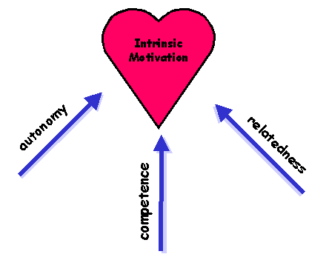
the heart of our Christian Stewardship is having the right motivation for giving.
Scriptural Text:
Deuteronomy 8:17, 18
2 Corinthians 9:9-14

Slide 30

Proposition
Although many promises of God are connected to giving, the heart of our Christian Stewardship is having the right motivation for giving.

Slide 31

We are motivated to give because:
1. Giving is one of God’s methods to support His Kingdom enterprise. (Deuteronomy 8:18)
2. Giving is good for us. (Acts 20:35)
3. Giving supports God’s ministers, clergy and laity. (Romans 13:6)
4. Giving in the light of the tax advantages. (Romans 13:7)
5. Give in the light of the Church’s survival. (1Corinthians 16:2)
6. Give in the light of God’s possible chastening and greater blessing. (Malachi 3:10, 11)
7. Give in the light of the fact that God loves a cheerful giver. (2Corinthians 9:7)
8. Give in the light of God’s Glory. (1Corinthians 10:31; 2Corinthians 4:15; 1Peter 4:11)

Slide 32


2Corinthians 9:6 - 8
6 But this I say, He which soweth sparingly shall reap also sparingly; and he which soweth bountifully shall reap also bountifully.
7 Every man according as he purposeth in his heart, so let him give; not grudgingly, or of necessity: for God loveth a cheerful giver.
8 And God is able to make all grace abound toward you; that ye, always having all sufficiency in all things, may abound to every good work:

